Slide 1
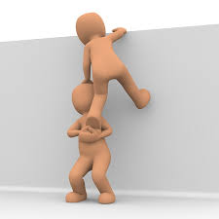
«Correctio Fraterna» (or Fraternal Correction)
Xaverian Theologate Manila, January 9, 2021
Community Formative Meeting

Slide 2
The spirit behind the correctio fraterna
Matthew 18:15 - "If another member of the church sins against you, go and point out the fault when the two of you are alone. If the member listens to you, you have regained that one”.
Colossians 3:16 - “Let the word of Christ dwell in you richly; teach and admonish one another in all wisdom; and with gratitude in your hearts sing psalms, hymns, and spiritual songs to God”.
1 Thessalonians 5:11 - “Therefore encourage one another and build up each other, as indeed you are doing”.
Romans 12:5 - “… so we, who are many, are one body in Christ, and individually we are members one of another”.

Slide 3
Spirituality of communion.
The Church is asking us to move from a very “individualistic” approach to spiritual life (me and God only, the other at most is the target of my charity work or is a co-worker) to a spirituality of communion (me, my brother, God)
Novo Millennio Ineunte 43 - We need to promote a spirituality of communion, […] A spirituality of communion indicates above all the heart's contemplation of the mystery of the Trinity dwelling in us, and whose light we must also be able to see shining on the face of the brothers and sisters around us. A spirituality of communion also means an ability to think of our brothers and sisters in faith within the profound unity of the Mystical Body, and therefore as "those who are a part of me".

Slide 4
Being concerned about other’s holiness and maturity
You are part of me: we are all members of the Mystical Body
We go to God together: if someone does not live out the Gospel, he affects the whole body, he becomes a hindrance for the others. Any positive step made by a member of the body, helps the whole community.
As missionaries, we should be as community the testimony of the presence of God (as singles and as community). This is what touches hearts. If we are not saints, we cannot be missionaries (cfr. RMi 90).

Slide 5
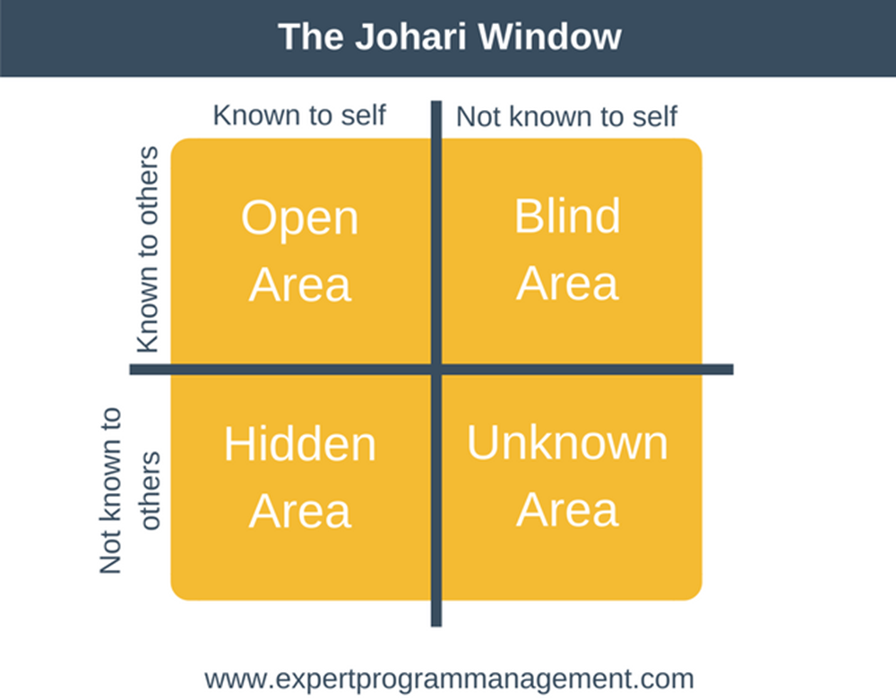
The Johari Window
There are things known by others but not by me. I need the help of others for discovering them (blind area + open area which I am resistant to address).

Slide 6
Negative and Positive
I am concerned about my path of sanctity but I am concerned also about your path of sanctity. I benefit of your sanctity.
I am concerned about my human maturity, but I am also concerned about your human maturity. I enjoy your talents and positive achievements.

Slide 7
Attitudes in giving the correction.
I put myself before God: I ask for His guidance and light. (How does God himself see this brother of mine? Is this only my personal impression or it is really something to be changed?).
I do it out of love: I do it for helping the other grow. The focus is the other, not me.
Not for revenge
Not because I cannot bear that behavior any longer
Not for pleasing (compliance)
Not for destroying the other
Freedom: I correct out of love, but I am in the disposition to accept you even if you do not change (mercy).

Slide 8
Some concrete aspects.
Be short and essential in your statements, choosing the most substantial things.
Avoid statements that address the other’s personality altogether: if possible, refer to concrete facts (not “you are selfish”, yes “ two days ago I saw you taking too much food and so nothing was left for the brother after you…”).
Be ready to give clarifications: put your name at the bottom of the correction statement.

Slide 9
How to receive it.
Receive the correction as an act of love for your own growth. Do not refuse it right away, do not be defensive. God tells you something through it.
Learn how to receive criticism: this is very helpful for the future (be sure that you will receive criticisms in less polite ways…).
A criticism on a specific behavior is not an overall attack to your person.
Do not take any correction as word of God: it is possible that someone sees things not objectively. But if something is highlighted by several people…, think twice before denying it. If you do not understand or agree, talk to the person who criticized you.
“Give back” to God all your positive achievements (they are His graces), be humble.

Slide 10
How to make the correction

Slide 11
Realistic expectations.
Correction will enhance our personal self awareness. This, in itself, is already an achievement, because it fosters the process toward maturity.
Not all the defects will be solved with the correctio. We still need patience and mercy. Endurance is also an important component in building our fraternal life.
Ephesians 4:1-2 – “I therefore, the prisoner in the Lord, beg you to lead a life worthy of the calling to which you have been called, with all humility and gentleness, with patience, bearing with one another in love…”.

Slide 12
My disposition in accompanying the other.
I know that any change is difficult (it is difficult for me too), so I give you time for starting a process and I accept the possibility that you fail and start again.
I know that behind any wrong behavior, reaction, or attitude there are your fears, stories, traumatic experiences, sufferings, unsolved relational problems (parents?), lack of self esteem, lack of self awareness etc. These are your personal cross (it is sacred soil) that I promise to bear with you, to make it lighter, together. So, be assured of my support!
We ask the help of God.
We practice fraternal correction (o correctio fraterna) so to get closer to Him and to our brothers and sister, and to testify His presence in our life to the others.

Slide 13
Thank YOU

